Slide 1
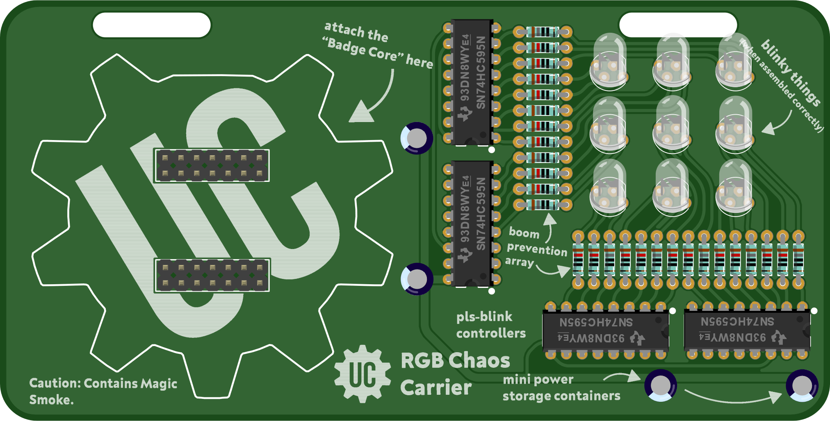

Electronic Badge Workshop
UC ENGINEERING SOCIETY

Slide 2
Safety First

